Slide 1
ShanghaiTech University
EE 115B: Digital Circuits
Fall 2024
Lecture 17
Hengzhao Yang
December 12, 2024

Slide 2
Counters
Asynchronous (serial or ripple): different stages are driven by different clocks
  Up-counters
  Down-counters
Synchronous (parallel): different stages are driven by the same clock
  Up-counters
  Down-counters

Slide 3
Asynchronous up-counter with T flip-flops
A 3-bit up-counter
  It counts the number of clock cycles
  Stage 1 is driven by Clock, stages 2 and 3 are driven by preceding output complement
  Counter output: Q₂Q₁Q₀ (MSB to LSB)
  Counter modulus (MOD number): number of different logic states represented by counter
  Modulo-8 or MOD-8: states 0-7
  Asynchronous (serial or ripple): three stages respond after different delays

Slide 4
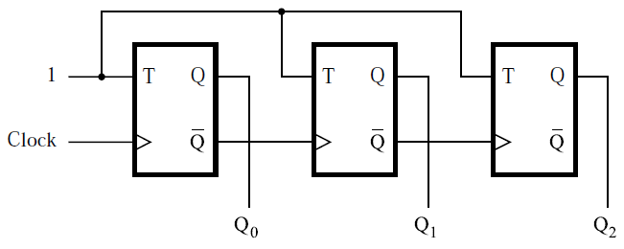
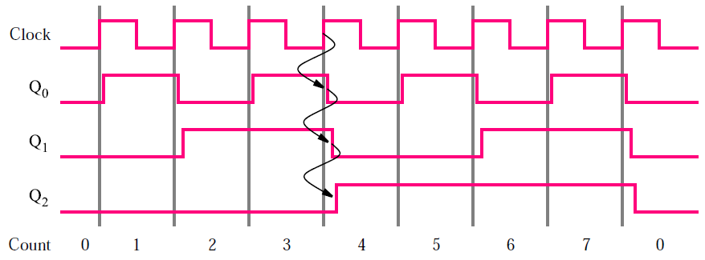
Asynchronous up-counter with T flip-flops

Slide 5
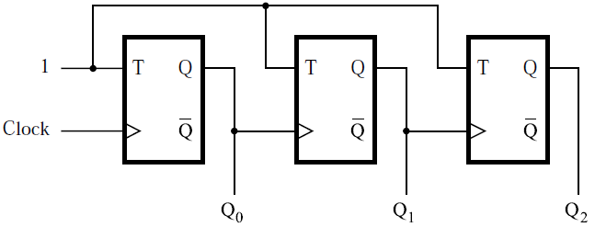
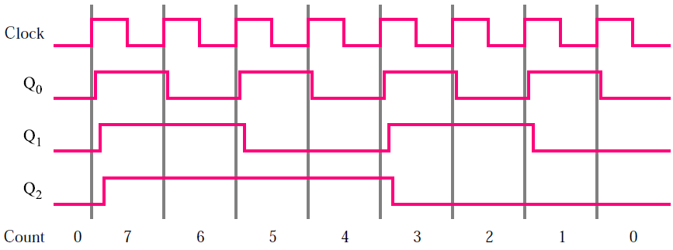
Asynchronous down-counter with T flip-flops

Slide 6
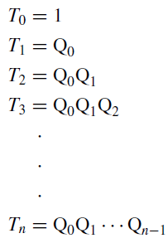
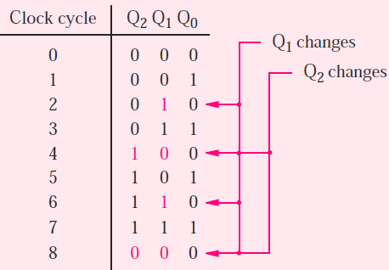
Synchronous up-counter with T flip-flops
Bit pattern: a given stage changes only when all the preceding stages satisfy Q=1
  Q₀ changes at each clock positive edge
  Q₁ changes only when Q₀=1
  Q₂ changes only when Q₀=1 AND Q₁=1
T input

Slide 7
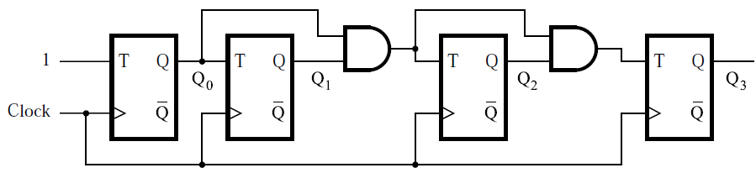
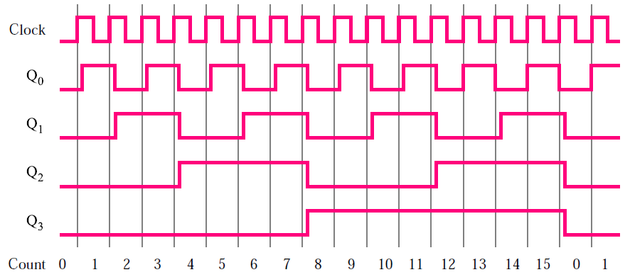
4-bit synchronous up-counter with T flip-flops

Slide 8
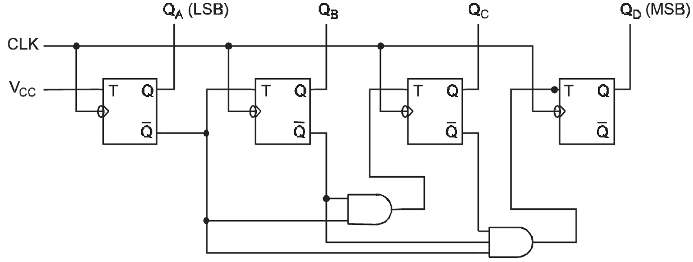
4-bit synchronous down-counter with T flip-flops

Slide 9
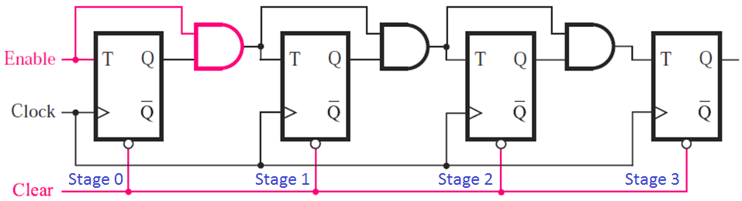
Enable and clear capabilities
4-bit synchronous up-counter with T flip-flops
  Clear=0: reset counter output to 0 (clear is asynchronous)
  T inputs: T₀=Enable, T₁=Q₀·Enable, T₂=Q₁·Q₀·Enable, T₃=Q₂·Q₁·Q₀·Enable
  Enable=1: normal operation as counter
  Enable=0: hold current state (all T inputs are 0)

Slide 10
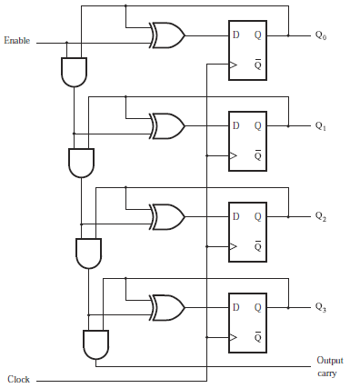
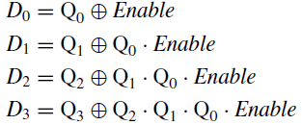
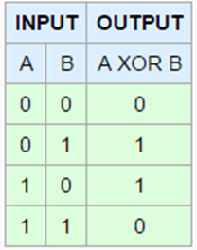
Synchronous counter with D flip-flop
D input
Operation (stage 0)
  A=Enable, B=Q₀
  Enable=1
    D₀=Q₀’, Q₀ flips
  Enable=0
    D₀=Q₀, Q₀ holds

Slide 11
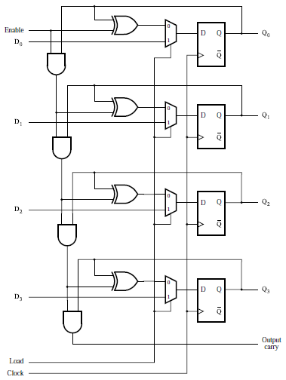
Synchronous counter with parallel loading
2-to-1 mux
  Load: mode selection signal
  Load=0: normal counter
  Load=1: load D₃D₂D₁D₀

Slide 12
Reset synchronization
Reset counter during its normal operation
Modulus (MOD number) of an N-bit counter is NOT always 2^{N}
A modulo-6 (MOD-6) counter
  States (counts): 0, 1, 2, 3, 4, 5
  Reset is needed when count reaches 5
  Synchronous reset
  Asynchronous reset

Slide 13
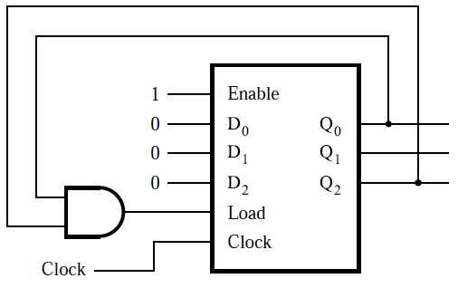
Synchronous reset
Reset: implemented using parallel loading mode
Reset condition: Q₂Q₁Q₀=101 (count 5)
Load=1 when Q₂=Q₀=1: load D₂D₁D₀=000 (reset counter)
Reset is synchronized by clock

Slide 14
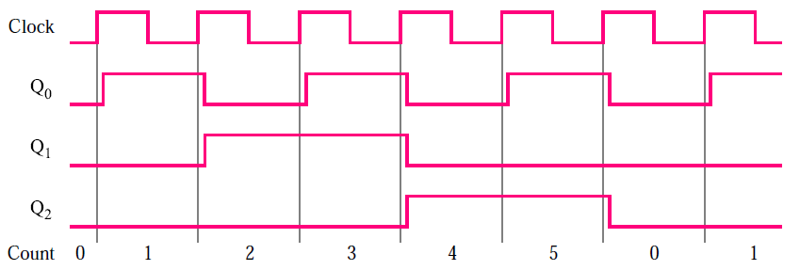
Synchronous reset
Timing diagram

Slide 15
Asynchronous reset
Reset: implemented using asynchronous clear signal generated by NAND gate
Reset condition: Q₂Q₁Q₀=101 (count 5)
Circuit modifications
  NAND gate: use Q₂=Q₀=1 to generate asynchronous clear signal (active low)
  Asynchronous clear: reset flip-flops
Reset is NOT synchronized by clock

Slide 16
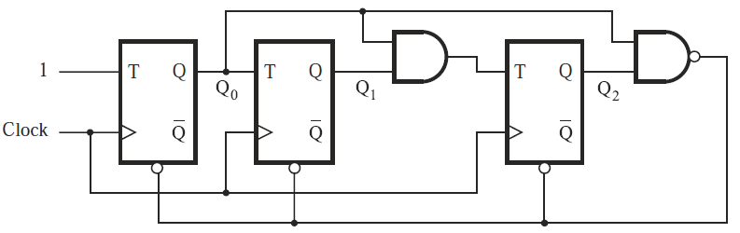
Asynchronous reset
Original counter (4-bit synchronous)
Modified counter with asynchronous reset (MOD-6)

Slide 17
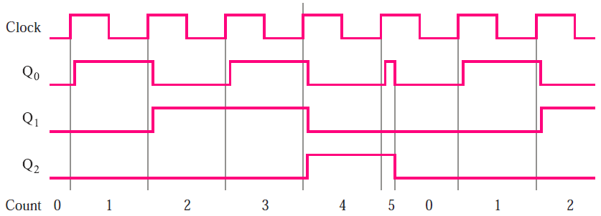
Asynchronous reset
Timing diagram
  State “5” duration is shorter than a clock cycle

Slide 18

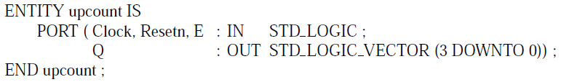
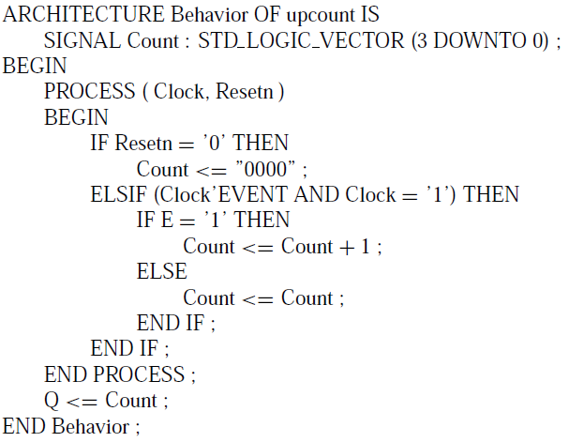
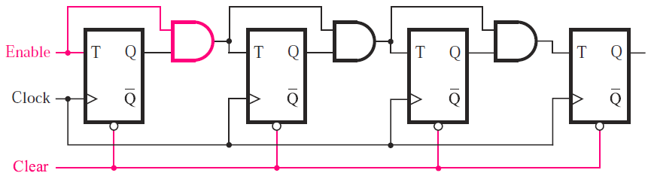
Code for 4-bit synchronous up-counter with asynchronous reset (clear) and enable
Ports
  Resetn: clear
  E: Enable
Signal
  Count: flip-flop outputs

Slide 19

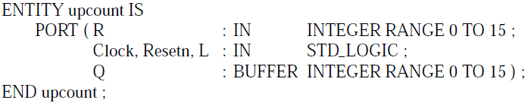
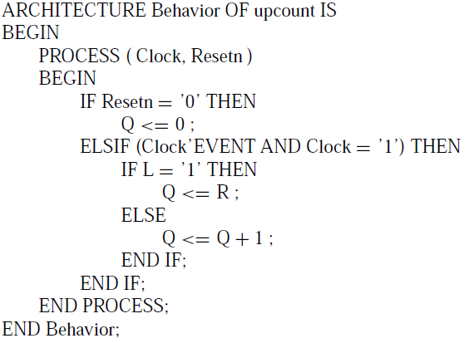
Code for 4-bit synchronous up-counter with asynchronous reset and parallel loading
L: load
R: parallel data
Integer range: 4-bit

Slide 20

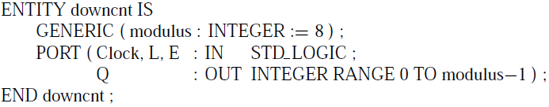
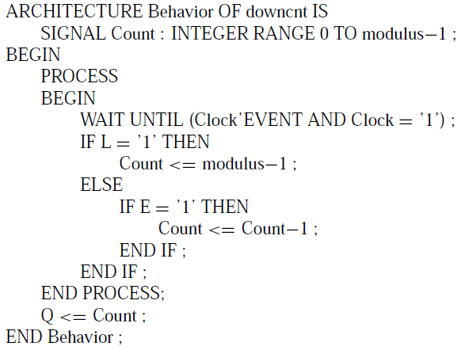
Code for 3-bit down-counter
Modulus: generic
E: enable
L: load
Initial count: modulus-1

